Slide 1
UNIT 1
Introduction to DBMS

Slide 2
Database
DBMS stands for Database Management System.
We can break it like this DBMS = Database + Management System.
Database is a collection of data and Management System is a set of programs to store and retrieve those data.
Based on this we can define DBMS like this: DBMS is a collection of inter-related data and set of programs to store & access those data in an easy and effective manner.

Slide 3
What is the need of DBMS?
Database systems are basically developed for large amount of data.
When dealing with huge amount of data, there are two things that require optimization:
Storage of data
and retrieval of data.

Slide 4
Storage
According to the principles of database systems, the data is stored in such a way that it acquires lot less space as the redundant data (duplicate data) has been removed before storage.

Slide 5
Example
In a banking system, suppose a customer is having two accounts, one is saving account and another is salary account. Let’s say bank stores saving account data at one place (these places are called tables we will learn them later) and salary account data at another place, in that case if the customer information such as customer name, address etc. are stored at both places then this is just a wastage of storage (redundancy/ duplication of data), to organize the data in a better way the information should be stored at one place and both the accounts should be linked to that information somehow. The same thing we achieve in DBMS.

Slide 6
Fast Retrieval of data
Along with storing the data in an optimized and systematic manner, it is also important that we retrieve the data quickly when needed.
Database systems ensure that the data is retrieved as quickly as possible.

Slide 7
Purpose of Database Systems
The main purpose of database systems is to manage the data.
Consider a university that keeps the data of students, teachers, courses, books etc. To manage this data we need to store this data somewhere where we can add new data, delete unused data, update outdated data, retrieve data, to perform these operations on data we need a Database management system that allows us to store the data in such a way so that all these operations can be performed on the data efficiently

Slide 8
Database Applications – DBMS
Applications where we use Database Management Systems are:
Telecom
Industry
Banking System
Sales
Airlines
Education sector
Online shopping

Slide 9
Drawbacks of File system
Data redundancy: Data redundancy refers to the duplication of data, lets say we are managing the data of a college where a student is enrolled for two courses, the same student details in such case will be stored twice, which will take more storage than needed. Data redundancy often leads to higher storage costs and poor access time.
Data inconsistency: Data redundancy leads to data inconsistency, lets take the same example that we have taken above, a student is enrolled for two courses and we have student address stored twice, now lets say student requests to change his address, if the address is changed at one place and not on all the records then this can lead to data inconsistency.

Slide 10
Data Isolation: Because data are scattered in various files, and files may be in different formats, writing new application programs to retrieve the appropriate data is difficult.
Dependency on application programs: Changing files would lead to change in application programs.
Atomicity issues: Atomicity of a transaction refers to “All or nothing”, which means either all the operations in a transaction executes or none.
Data Security: Data should be secured from unauthorized access, for example a student in a college should not be able to see the payroll details of the teachers, such kind of security constraints are difficult to apply in file processing systems.

Slide 11
Advantage of DBMS over file system
No redundant data: Redundancy removed by data normalization. No data duplication saves storage and improves access time.
Data Consistency and Integrity: As we discussed earlier the root cause of data inconsistency is data redundancy, since data normalization takes care of the data redundancy, data inconsistency also been taken care of as part of it.
Data Security: It is easier to apply access constraints in database systems so that only authorized user is able to access the data. Each user has a different set of access thus data is secured from the issues such as identity theft, data leaks and misuse of data.
Privacy: Limited access means privacy of data.

Slide 12
Easy access to data : Database systems manages data in such a way so that the data is easily accessible with fast response times.
Easy recovery: Since database systems keeps the backup of data, it is easier to do a full recovery of data in case of a failure.
Flexible: Database systems are more flexible than file processing systems.

Slide 13
Disadvantages of DBMS
DBMS implementation cost is high compared to the file system
Complexity: Database systems are complex to understand
Performance: Database systems are generic, making them suitable for various applications. However this feature affect their performance for some applications

Slide 14
Question?
What is a database? a) Organized collection of information that cannot be accessed, updated, and managed b) Collection of data or information without organizing c) Organized collection of data or information that can be accessed, updated, and managed d) Organized collection of data that cannot be updated

Slide 15
Question
What is DBMS? a) DBMS is a collection of queries b) DBMS is a high-level language c) DBMS is a programming language d) DBMS stores, modifies and retrieves data

Slide 16
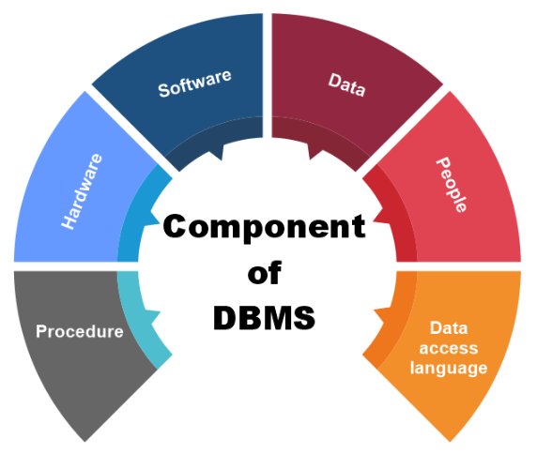
Components of DBMS
Hardware, Software, Data, Database Access Language, Procedures and Users all together form the components of a DBMS.

Slide 17
Hardware
When we say Hardware, we mean computer, hard disks, I/O channels for data, and any other physical component involved before any data is successfully stored into the memory.
When we run Oracle or MySQL on our personal computer, then our computer's Hard Disk, our Keyboard using which we type in all the commands, our computer's RAM, ROM all become a part of the DBMS hardware.

Slide 18
Software
This is the main component, as this is the program which controls everything. The DBMS software is more like a wrapper around the physical database, which provides us with an easy-to-use interface to store, access and update data.
The DBMS software is capable of understanding the Database Access Language and interpret it into actual database commands to execute them on the DB.

Slide 19
Data
Data is that resource, for which DBMS was designed. The motive behind the creation of DBMS was to store and utilize data.
In a typical Database, the user saved Data is present and meta data is stored.
Metadata is data about the data. This is information stored by the DBMS to better understand the data stored in it.

Slide 20
Example
When I store my Name in a database, the DBMS will store when the name was stored in the database, what is the size of the name, is it stored as related data to some other data, or is it independent, all this information is metadata.

Slide 21
Procedures
Procedures refer to general instructions to use a database management system. This includes procedures to setup and install a DBMS, To login and logout of DBMS software, to manage databases, to take backups, generating reports etc.

Slide 22
Database Access Language
Database Access Language is a language used to write commands to access, update, and delete data stored in a database.
Users can write commands using Database Access Language before submitting them to the database for execution.
Through utilizing the language, users can create new databases, tables, insert data, and delete data.

Slide 23
Users
Database users are categorized based up on their interaction with the database.
These are different types of database users in DBMS:
Database Administrator (DBA)
Naive / Parametric End Users
System Analyst
Sophisticated Users
Database Designers
Application Programmers
Casual Users / Temporary Users

Slide 24
1. Database Administrator (DBA)
Database Administrator (DBA) is a person/team who defines the schema and also controls the 3 levels of database.
The DBA will then create a new account id and password for the user if he/she need to access the database.
DBA is also responsible for providing security to the database and he allows only the authorized users to access/modify the data base.
DBA is responsible for the problems such as security breaches and poor system response time.

Slide 25
DBA also monitors the recovery and backup and provide technical support.
The DBA has a DBA account in the DBMS which called a system or superuser account.
DBA repairs damage caused due to hardware and/or software failures.
DBA is the one having privileges to perform DCL (Data Control Language) operations such as GRANT and REVOKE, to allow/restrict a particular user from accessing the database.

Slide 26
2. Naive / Parametric End Users
Parametric End Users are the unsophisticated who don’t have any DBMS knowledge but they frequently use the database applications in their daily life to get the desired results.
For examples, Railway’s ticket booking users are naive users. Clerks in any bank is a naive user because they don’t have any DBMS knowledge but they still use the database and perform their given task.

Slide 27
3. System Analyst
System Analyst is a user who analyzes the requirements of parametric end users. They check whether all the requirements of end users are satisfied.

Slide 28
4. Sophisticated Users
Sophisticated users can be engineers, scientists, business analyst, who are familiar with the database. They can develop their own database applications according to their requirement. They don’t write the program code but they interact the database by writing SQL queries directly through the query processor.

Slide 29
5. Database Designers
Data Base Designers are the users who design the structure of database which includes tables, indexes, views, triggers, stored procedures and constraints which are usually enforced before the database is created or populated with data.
He/she controls what data must be stored and how the data items to be related.
It is responsibility of Database Designers to understand the requirements of different user groups and then create a design which satisfies the need of all the user groups.

Slide 30
6. Application Programmers
Application Programmers also referred as System Analysts or simply Software Engineers, are the back-end programmers who writes the code for the application programs. They are the computer professionals.
These programs could be written in Programming languages such as Visual Basic, Developer, C, FORTRAN, COBOL etc. Application programmers design, debug, test, and maintain set of programs called “canned transactions” for the Naive (parametric) users in order to interact with database.

Slide 31
7. Casual Users / Temporary Users
Casual Users are the users who occasionally use/access the database but each time when they access the database they require the new information.
For example, Middle or higher level manager.

Slide 32
DBMS Architecture
. Database management systems architecture will help us understand the components of database system and the relation among them.
The architecture of DBMS depends on the computer system on which it runs.
For example, in a client-server DBMS architecture, the database systems at server machine can run several requests made by client machine.
We will understand this communication with the help of diagrams.

Slide 33
Types of DBMS Architecture
There are three types of DBMS architecture:
Single tier architecture
2. Two tier architecture
3. Three tier architecture

Slide 34
Single tier architecture
In this type of architecture, the database is readily available on the client machine, any request made by client doesn’t require a network connection to perform the action on the database.
For example, lets say you want to fetch the records of employee from the database and the database is available on your computer system, so the request to fetch employee details will be done by your computer and the records will be fetched from the database by your computer as well. This type of system is generally referred as local database system.

Slide 35
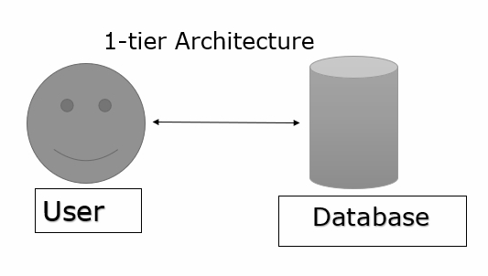
Single tier architecture

Slide 36
Any changes or updates that are done will reflect directly to the database.
The 1-tier architecture is used for the development of applications where a programmer directly communicates with the database for very fast response.
It is used for enhancement of the local application.

Slide 37
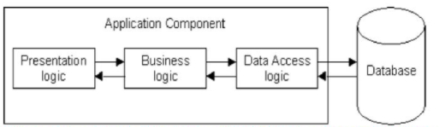
Example
The three-layer solution is deployed on single tier like personal workstations.
In the below diagram all three layers like presentation, business and data access logic are on same machine.

Slide 38
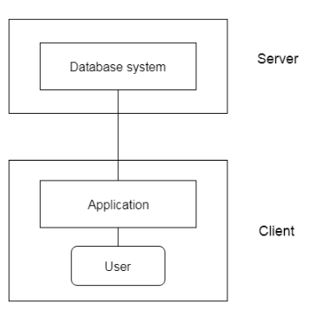
Two tier architecture

Slide 39
Two tier architecture
In two-tier architecture, the Database system is present at the server machine and the DBMS application is present at the client machine, these two machines are connected with each other through a reliable network as shown in the above diagram.
Whenever client machine makes a request to access the database present at server using a query language like sql, the server perform the request on the database and returns the result back to the client.
The application connection interface such as JDBC, ODBC(Open Database Connectivity) are used for the interaction between server and client.

Slide 40
When there are a large number of users at client side to access the database, this architecture gives a poor performance.
The server side is responsible for delivering the functionalities like query processing and management of transactions.
For example − Oracle, Sybase, Microsoft SQL Server etc.

Slide 41
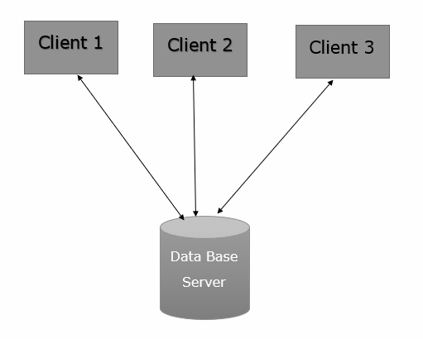
Example
The Tier-2 architecture of DBMS is diagrammatically represented as follows

Slide 42
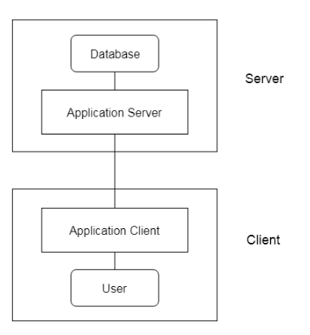
Three tier architecture

Slide 43
Three tier architecture
In three-tier architecture, another layer is present between the client machine and server machine.
In this architecture, the client application doesn’t communicate directly with the database systems present at the server machine, rather the client application communicates with server application and the server application internally communicates with the database system present at the server.

Slide 44
Mainly, the 3-tier is used for large applications on the web.
The features of 3-tier architecture are data backup, recovery, security, and concurrency control.

Slide 45
Layers
The 3-tier architecture consists of the three layers as follows −
Presentation layer − This layer is also called the client layer. The front-end layer consists of a user interface. The main purpose is to communicate with the application layer.
Application layer − This layer is also called the business logic layer. It acts as a middle layer between the client and the database server which are used to exchange partially processed data.
Database layer − In this layer the data or information is stored. This layer performs operations like insert, update and delete to connect with the database.

Slide 46
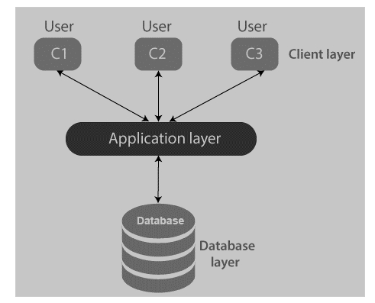
Example

Slide 47
Question
What is TRUE about 1-tier architecture?
It is directly not available to the user
Changes are not done on the database
No handy tool is provided for the end user
It is not used for the development of local application

Slide 48
Answer:
C) No handy tool is provided for the end user

Slide 49
Question
Basic client-server model is similar to –
2-tier architecture
3-tier architecture
4-tier architecture
5-tier architecture

Slide 50
Question
Which API is used for the interaction in 2-tier architecture?
ODBC
JDBC
Both A. and B.
None of the above

Slide 51
Question
3-tier architecture is used in –
Large web application
Small web application
Both large and small web application
Neither small nor large web application

Slide 52
View of Data in DBMS
View of data in DBMS narrate how the data is visualized at each level of data abstraction.
Data abstraction allow developers to keep complex data structures away from the users.
The developers achieve this by hiding the complex data structures through levels of abstraction.

Slide 53
Data abstraction
Data abstraction is hiding the complex data structure in order to simplify the user’s interface of the system. It is done because many of the users interacting with the database system are not that much computer trained to understand the complex data structures of the database system.
To achieve data abstraction, we will discuss a Three-Schema architecture which abstracts the database at three levels discussed below:

Slide 54
Three-Schema Architecture
The main objective of this architecture is to have an effective separation between the user interface and the physical database. So, the user never has to be concerned regarding the internal storage of the database and it has a simplified interaction with the database system.
The three-schema architecture defines the view of data at three levels:
Physical level (internal level)
Logical level (conceptual level)
View level (external level)

Slide 55
1. Physical Level/ Internal Level
The physical or the internal level schema describes how the data is stored in the hardware. It also describes how the data can be accessed.
The physical level shows the data abstraction at the lowest level and it has complex data structures.
Only the database administrator operates at this level.

Slide 56
2. Logical Level/ Conceptual Level
It is a level above the physical level. Here, the data is stored in the form of the entity set, entities, their data types, the relationship among the entity sets, user operations performed to retrieve or modify the data and certain constraints on the data. Well adding constraints to the view of data adds the security. As users are restricted to access some particular parts of the database.
It is the developer and database administrator who operates at the logical or the conceptual level.

Slide 57
3. View Level/ User level/ External level
It is the highest level of data abstraction and exhibits only a part of the whole database. It exhibits the data in which the user is interested. The view level can describe many views of the same data.
Here, the user retrieves the information using different application from the database.

Slide 58
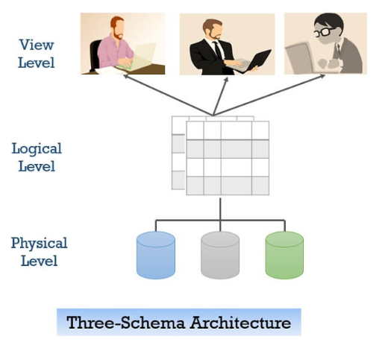
Three-Schema Architecture

Slide 59
Example
We have to create a database of a college. Now, what entity sets would be involved? Student, Lecturer, Department, Course and so on…
Now, the entity sets Student, Lecturer, Department, Course will be stored in the storage as the consecutive blocks of the memory location. This is the physical or internal level and is hidden from the programmers but the database administrator is it aware of it.
At the logical level, the programmers define the entity sets and relationship among these entity sets using a programming language like SQL. So, the programmers work at the logical level and even the database administrator also operates at this level.
At the view level, the users have the set of applications which they use to retrieve the data they are interested in.

Slide 60
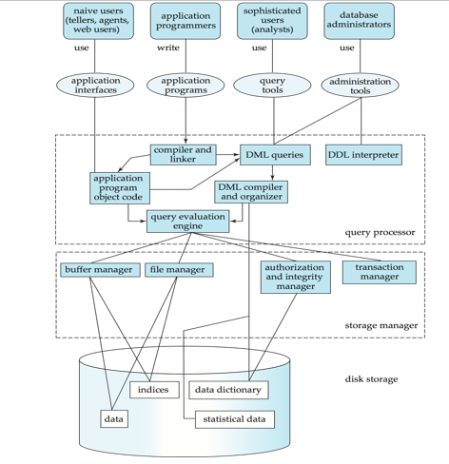

Slide 61
Data Independence
Data Independence is defined as a property of DBMS that helps you to change the Database schema at one level of a database system without requiring to change the schema at the next higher level. Data independence helps you to keep data separated from all programs that make use of it.
You can use this stored data for computing and presentation. In many systems, data independence is an essential function for components of the system.

Slide 62
Types of Data Independence
In DBMS there are two types of data independence
Physical data independence
Logical data independence.

Slide 63
Physical Data Independence
Physical data independence defines the extent up to which the data schema can be changed at the physical or internal level without modifying the data schema at logical and view level.
Well, the physical schema is changed if we add additional storage to the system or we reorganize some files to enhance the retrieval speed of the records.

Slide 64
Logical Data Independence
Logical data independence describes the degree up to which the logical or conceptual schema can be changed without modifying the external schema. Now, a question arises what is the need to change the data schema at a logical or conceptual level?
Well, the changes to data schema at the logical level are made either to enlarge or reduce the database by adding or deleting more entities, entity sets, or changing the constraints on data.

Slide 65
Instances and Schemas

Slide 66
Instance
An instance can be defined as the information stored in the database at a particular point of time.
Let us discuss it with the help of an example.
As we discussed above the database comprises of several entity sets and the relationship between them. Now, the data in the database keeps on changing with time. As we keep inserting or deleting the data to and from the database.
Now, at a particular time if we retrieve any information from the database then that corresponds to an instance.

Slide 67
Schema
The overall design of the database is called the database schema.
Schemas are changed infrequently, if at all.

Slide 68
Example
A database schema corresponds to the variable declarations (along with associated type definitions) in a program.
Each variable has a particular value at a given instant. The values of the variables in a program at a point in time correspond to an instance of a database schema.

Slide 69
Database systems have several schemas, partitioned according to the levels of abstraction. The physical schema describes the database design at the physical level, while the logical schema describes the database design at the logical level.
A database may also have several schemas at the view level, sometimes called subschemas, that describe different views of the database.
Of these, the logical schema is by far the most important, in terms of its effect on application programs, since programmers construct applications by using the logical schema.
The physical schema is hidden beneath the logical schema, and can usually be changed easily without affecting application programs.

Slide 70
Question
Which Of three schemas used in three-schema model represents how users view database? A). Internal B). External C). Implementation D). Conceptual

Slide 71
Question
Which of three schemas used in three-schema model is a complete logical View of database? A).Conceptual B).External C). Internal D). Implementation

Slide 72
Database Models
A Database model defines the logical design and structure of a database and defines how data will be stored, accessed and updated in a database management system. While the Relational Model is the most widely used database model, there are other models too:
Hierarchical Model
Network Model
Entity-Relationship Model
Relational Model

Slide 73
Hierarchical Model
This database model organizes data into a tree-like-structure, with a single root, to which all the other data is linked. The hierarchy starts from the Root data, and expands like a tree, adding child nodes to the parent nodes.
In this model, a child node will only have a single parent node.
This model efficiently describes many real-world relationships like index of a book, recipes etc.

Slide 74
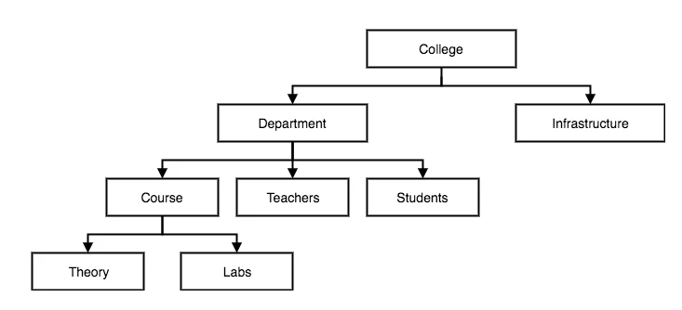
In hierarchical model, data is organized into tree-like structure with one one-to-many relationship between two different types of data, for example, one department can have many courses, many professors and of-course many students.

Slide 75
Network Model
This is an extension of the Hierarchical model. In this model data is organized more like a graph, and are allowed to have more than one parent node.
In this database model data is more related as more relationships are established in this database model. Also, as the data is more related, hence accessing the data is also easier and fast. This database model was used to map many-to-many data relationships.
This was the most widely used database model, before Relational Model was introduced.

Slide 76
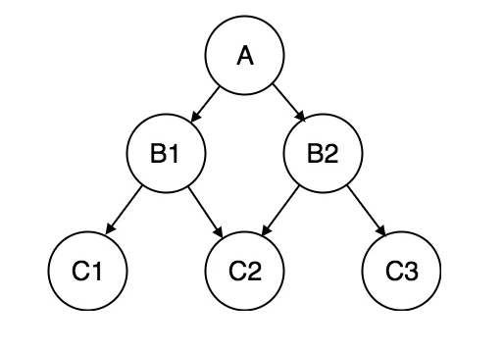
Network Model

Slide 77
Entity-relationship Model
In this database model, relationships are created by dividing object of interest into entity and its characteristics into attributes.
Different entities are related using relationships.
E-R Models are defined to represent the relationships into pictorial form to make it easier for different stakeholders to understand.
This model is good to design a database, which can then be turned into tables in relational model(explained below).

Slide 78
Example
Let's take an example, If we have to design a School Database, then Student will be an entity with attributes name, age, address etc. As Address is generally complex, it can be another entity with attributes street name, pincode, city etc, and there will be a relationship between them.

Slide 79
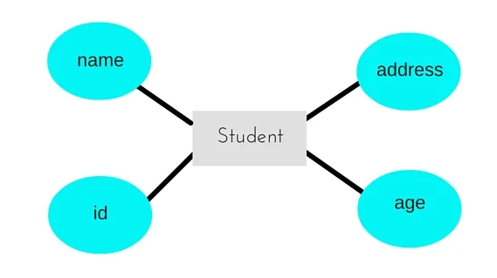

Slide 80
Relational Model
In this model, data is organized in two-dimensional tables and the relationship is maintained by storing a common field.
This model was introduced by E.F Codd in 1970, and since then it has been the most widely used database model, Infact, we can say the only database model used around the world.
The basic structure of data in the relational model is tables. All the information related to a particular type is stored in rows of that table.
Hence, tables are also known as relations in relational model.

Slide 81
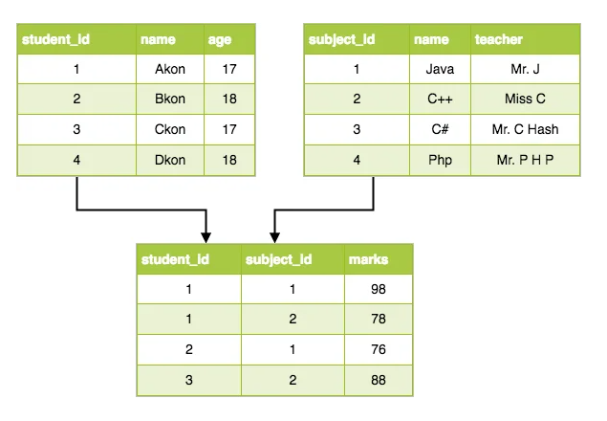
Example

Slide 82
Database Access Languages
Database languages, also known as query languages or data query languages, are a classification of programming languages that developers use to define and access databases, which are collections of organized data that users can access electronically.
These languages allow users to complete tasks such as controlling access to data, defining and updating data and searching for information within the database management system (DBMS).

Slide 83
Categories of database languages
Here are four types of database languages and their uses:
Data definition language (DDL)
Data manipulation language (DML)
Data control language (DCL)
Transaction control language (TCL)

Slide 84
Data definition language (DDL)
Data definition language (DDL) creates the framework of the database by specifying the database schema, which is the structure that represents the organization of data.
Its common uses include the creation and alteration of tables, files, indexes and columns within the database.
This language also allows users to rename or drop the existing database or its components.

Slide 85
List of DDL statements
CREATE: Creates a new database or object, such as a table, index or column
ALTER: Changes the structure of the database or object
DROP: Deletes the database or existing objects
RENAME: Renames the database or existing objects

Slide 86
Data manipulation language (DML)
Data manipulation language (DML) provides operations that handle user requests, offering a way to access and manipulate the data that users store within a database.
Its common functions include inserting, updating and retrieving data from the database.

Slide 87
List of DML statements
INSERT: Adds new data to the existing database table
UPDATE: Changes or updates values in the table
DELETE: Removes records or rows from the table
SELECT: Retrieves data from the table or multiple tables

Slide 88
Data control language (DCL)
Data control language (DCL) controls access to the data that users store within a database. Essentially, this language controls the rights and permissions of the database system. It allows users to grant or revoke privileges to the database.
Here's a list of DCL statements:
GRANT: Gives a user access to the database
REVOKE: Removes a user's access to the database

Slide 89
Transaction control language (TCL)
Transaction control language (TCL) manages the transactions within a database. Transactions group a set of related tasks into a single, executable task. All the tasks must succeed in order for the transaction to work.
Here's a list of TCL statements:
COMMIT: Carries out a transaction
ROLLBACK: Restores a transaction if any tasks fail to execute
SAVEPOINT: Sets a point in a transaction to save

Slide 90
Question
. ………………… is a full form of SQL.
Standard query language
Sequential query language
Structured query language
Server side query language

Slide 91
Question
An advantage of the database management approach is
data is dependent on programs
data redundancy increases
data is integrated and can be accessed by multiple programs
none of the above

Slide 92
Question
Grant and revoke are ……. statements.
DDL
TCL
DCL
DML

Slide 93
ER Model

Slide 94
ER Model
ER model stands for an Entity-Relationship model. It is a high-level data model. This model is used to define the data elements and relationship for a specified system.
It develops a conceptual design for the database. It also develops a very simple and easy to design view of data.
In ER modeling, the database structure is portrayed as a diagram called an entity-relationship diagram.

Slide 95
ER model makes use of ER diagrams, which are the diagrams sketched to design a database. ER diagrams are built on three basic concepts: entities, attributes, and relationships between them.
An ER diagram defines entities, associated attributes, and relationships between entities. This helps visualize the logical structure of the database.

Slide 96
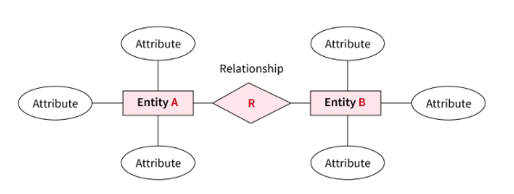
Example

Slide 97
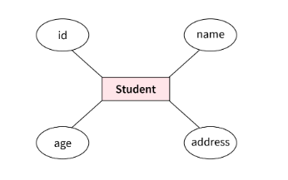
For Example
design a database for a school. In this database, a student is an entity with attributes such as an address, name, id, age, grades, etc.

Slide 98
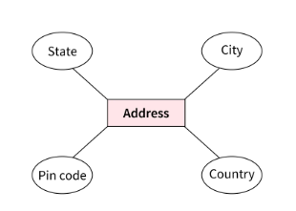
The address can be another entity with attributes like city, street name, pin code, etc and there will be a relationship between them.

Slide 99
Component of ER Diagram
The ER diagram consists of three basic concepts:
Entities
Attributes
Relationships

Slide 100
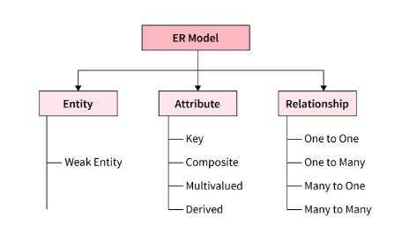
Strong Entiry

Slide 101
Entity
An entity is anything in the real world, such as an object, class, person, or place.
Objects that physically exist and are logically constructed in the real world are called entities.
Each entity consists of several characteristics or attributes that describe that entity.
For example, if a person is an entity, its attributes or characteristics are age, name, height, weight, occupation, address, hobbies, and so on.

Slide 102
Entity Set
It is a group of entities of similar kinds. It can contain entities with attributes that share similar values. It's collectively a group of entities of a similar type.
For example, a car entity set, an animal entity set, a bank account entity set, and so on.

Slide 103
Entity types
Entity types are the basic building blocks for describing the structure of data. It's a category of a particular entity in an entity set.
In summary, an Entity is an object of a Type Entity and the set of all entities is called an entity set.
For Example: E1 is an entity having Entity Type Student and set of all students is called Entity Set.

Slide 104
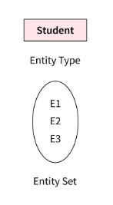
Example

Slide 105
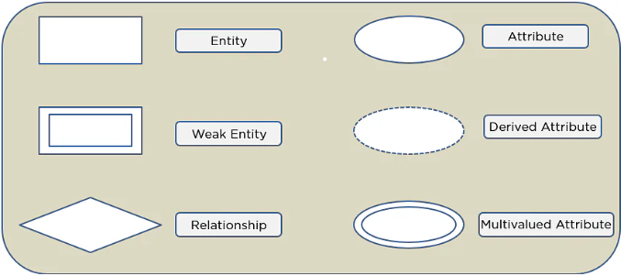
Symbols Used in ER Diagrams

Slide 106
Types of Entities
Entities are of two types:
Strong Entity
Weak Entity

Slide 107
Strong Entity
A strong entity is an entity type that has a key attribute. It doesn't depend on other entities in the schema. A strong entity always has a primary key, and it is represented by a single rectangle in the ER diagram.
Example – roll_number identifies each student of the organization uniquely and hence, we can say that the student is a strong entity type.

Slide 108
Weak Entity
Weak entity type doesn’t have a key attribute and so we cannot uniquely identify them by their attributes alone. Therefore, a foreign key must be used in combination with its attributes to create a primary key. They are called Weak entity types because they can’t be identified on their own. It relies on another powerful entity for its unique identity.
A weak entity is represented by a double-outlined rectangle in ER diagrams.

Slide 109

Example
The address can't be used to uniquely identify students as there can be many students from the same locality. So, for this, we need an attribute of Strong Entity Type i.e ‘student’ to uniquely identify entities of Address Entity Type.
The relationship between a weak entity type and a strong entity type is shown with a double-outlined diamond instead of a single-outlined diamond.

Slide 110
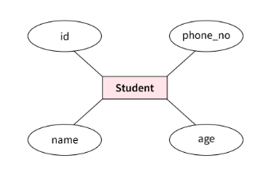
Attributes
Attributes are the characteristics or properties which define the entity type. In ER diagram, the attribute is represented by an oval.
For example, here id, Name, Age, and Mobile_No are the attributes that define the entity type Student

Slide 111
Types of Attributes
These are the types of attributes:
Simple attribute
Composite attribute
Multivalued attribute
Derived attribute

Slide 112
Simple/Key Attribute
Attributes that cannot be further decomposed into sub-attributes are called simple attributes.
It's an atomic value and is also known as the key attribute.
The simple attributes are represented by an oval shape in ER diagrams with the attribute name underlined.

Slide 113
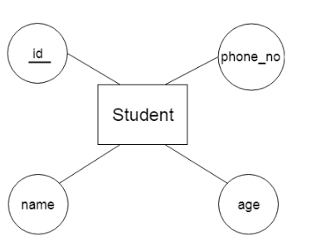
Example
As you can see from the above image, the attributes id is represented in the shape of an ellipse along with having the attribute name underlined.

Slide 114
Composite attribute
An attribute that is composed of many other attributes and can be decomposed into simple attributes is known as a composite attribute. The composite attribute is represented by an ellipse.
For example, a student's address can be divided into city, state, country, and pin code or a full name can be divided into first name, middle name, and last name.

Slide 115
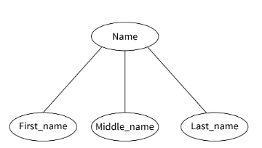
Example

Slide 116
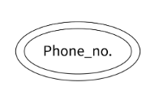
Multivalued attribute
Multivalued attributes are attributes that can have more than one value. The double oval is used to represent a multivalued attribute.
For example, the mobile_number of a student is a multivalued attribute as one student can have more than one mobile number.

Slide 117
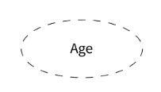
Derived attribute
Derived attributes are the ones that can be derived from other attributes of an entity type. The derived attributes are represented by a dashed oval symbol in the ER diagram.
For example, the age attribute can be derived from the date of birth (DOB) attribute. So, it's a derived attribute.

Slide 118
Example
The complete student (represented by the rectangle shape) entity type is shown by the below diagram having different attributes, where address is the composite attribute, age is the derived attribute, phone number is the multivalued attribute, and roll number is the key attribute.

Slide 119
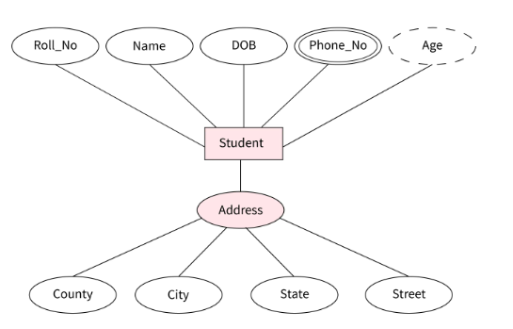

Slide 120
Relationship
The diamond shape showcases a relationship in the ER diagram.
It depicts the relationship between two entities.
In the example below, both the student and the course are entities, and study is the relationship between them.

Slide 121
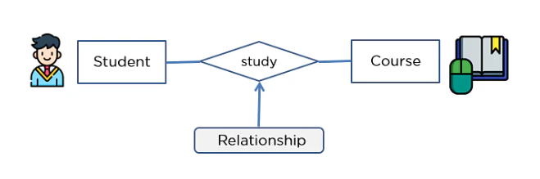
Example

Slide 122
Cardinality in DBMS
Cardinality represents the number of times an entity of an entity set participates in a relationship set. Or we can say that the cardinality of a relationship is the number of tuples (rows) in a relationship.

Slide 123
Types of relationships
One-to-One Relationship
One-to-Many Relationship
Many-to-One Relationship
Many-to-Many Relationship

Slide 124
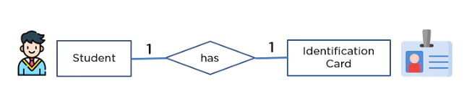
One-to-One Relationship
When a single element of an entity is associated with a single element of another entity, it is called a one-to-one relationship.
For example, a student has only one identification card and an identification card is given to one person.

Slide 125
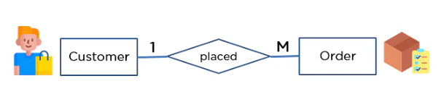
One-to-Many Relationship
When a single element of an entity is associated with more than one element of another entity, it is called a one-to-many relationship
For example, a customer can place many orders, but an order cannot be placed by many customers.

Slide 126
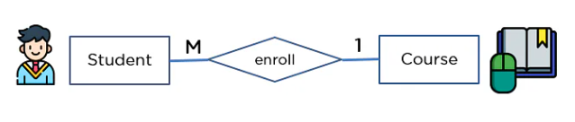
Many-to-One Relationship
When more than one element of an entity is related to a single element of another entity, then it is called a many-to-one relationship.
For example, students have to opt for a single course, but a course can have many students.

Slide 127
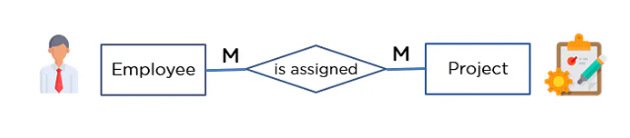
Many-to-Many Relationship
When more than one element of an entity is associated with more than one element of another entity, this is called a many-to-many relationship.
For example, you can assign an employee to many projects and a project can have many employees.

Slide 128
How to Draw an ER Diagram?
Below are some important points to draw ER diagram:
First, identify all the Entities. Embed all the entities in a rectangle and label them properly.
Identify relationships between entities and connect them using a diamond in the middle, illustrating the relationship. Do not connect relationships with each other.
Connect attributes for entities and label them properly.
Eradicate any redundant entities or relationships.
Verbs often describe relationships between entities.
Make sure your ER Diagram supports all the data provided to design the database.

Slide 129
Participation Constraints
The participation constraint specifies the number of instances of an entity can participate in a relationship set.
Types of Participation Constraints:
Total Participation
Partial Participation

Slide 130
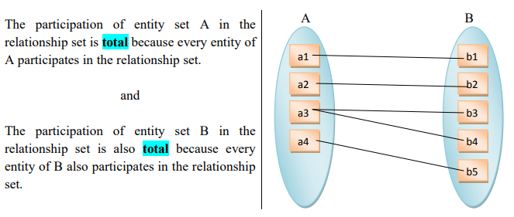
Total Participation
The Participation of an entity set E in a relationship set R is said to be total if every entity in E participates in at least one relationship in R.

Slide 131
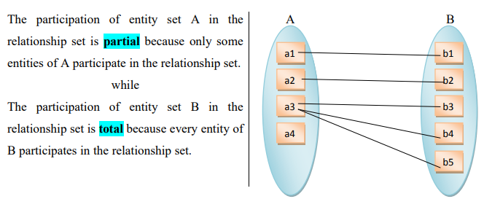
Partial Participation
The participation of an entity set E in relationship set R is said to be partial if only some entities in E participate in relationships in R.

Slide 132
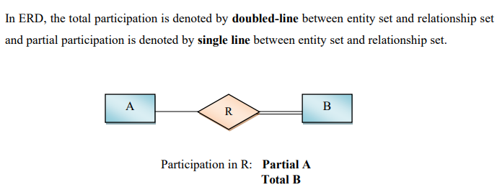

Slide 133
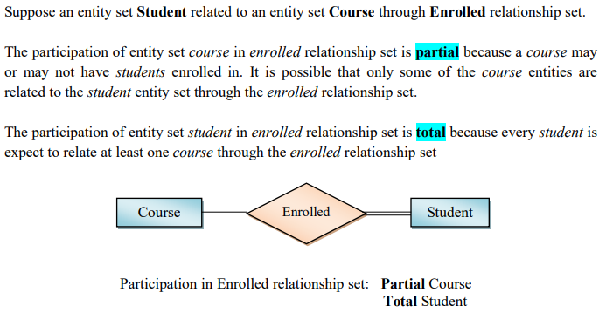
Example

Slide 134
DBMS Generalization
Generalization is a process in which the common attributes of more than one entities form a new entity. This newly formed entity is called generalized entity.
Generalization Example
Let say we have two entities Student and Teacher.
Attributes of Entity Student are: Name, Address & Grade
Attributes of Entity Teacher are: Name, Address & Salary

Slide 135
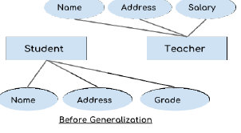
The ER diagram before generalization
These two entities have two common attributes: Name and Address, we can make a generalized entity with these common attributes.

Slide 136
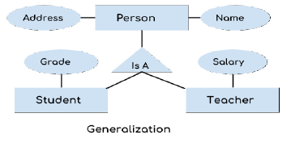
The ER diagram after generalization

Slide 137
We have created a new generalized entity Person and this entity has the common attributes of both the entities.
As you can see in the following ER diagram that after the generalization process the entities Student and Teacher only has the specialized attributes Grade and Salary respectively and their common attributes (Name & Address) are now associated with a new entity Person which is in the relationship with both the entities (Student & Teacher).

Slide 138
NOTE
Generalization uses bottom-up approach where two or more lower level entities combine together to form a higher level new entity.
The new generalized entity can further combine together with lower level entity to create a further higher level generalized entity.

Slide 139
DBMS Specialization
Specialization is a process in which an entity is divided into sub-entities. You can think of it as a reverse process of generalization, in generalization two entities combine together to form a new higher level entity. Specialization is a top-down process.
The idea behind Specialization is to find the subsets of entities that have few distinguish attributes.
For example – Consider an entity employee which can be further classified as sub-entities Technician, Engineer & Accountant because these sub entities have some distinguish attributes.

Slide 140
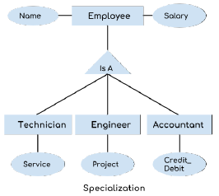

Slide 141
In the above diagram, we can see that we have a higher level entity “Employee” which we have divided in sub entities “Technician”, “Engineer” & “Accountant”. All of these are just an employee of a company, however their role is completely different and they have few different attributes.
Just for the example, Here it is shown that Technician handles service requests, Engineer works on a project and Accountant handles the credit & debit details. All of these three employee types have few attributes common such as name & salary which we had left associated with the parent entity “Employee” as shown in the above diagram.

Slide 142
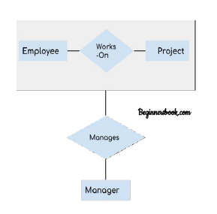
DBMS Aggregation
Aggregation is a process in which a single entity alone is not able to make sense in a relationship so the relationship of two entities acts as one entity.
Example:

Slide 143
In real world, we know that a manager not only manages the employee working under them but he has to manage the project as well. In such scenario if entity “Manager” makes a “manages” relationship with either “Employee” or “Project” entity alone then it will not make any sense because he has to manage both.
In these cases the relationship of two entities acts as one entity.
In our example, the relationship “Works-On” between “Employee” & “Project” acts as one entity that has a relationship “Manages” with the entity “Manager”.

Slide 144
Relational Model

Slide 145
Relational Model
In relational model, the data and relationships are represented by collection of inter-related tables. Each table is a group of column and rows, where column represents attribute of an entity and rows represents records.
The use of tables to store the data provided a straightforward, efficient, and flexible way to store and access structured information. Because of this simplicity, this data model provides easy data sorting and data access. Hence, it is used widely around the world for data storage and processing.

Slide 146
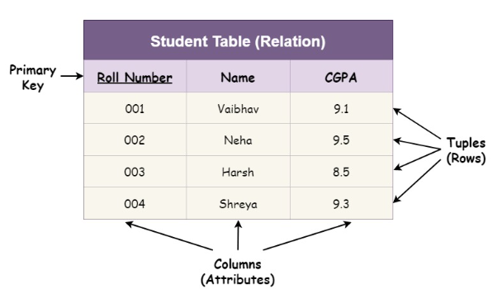
Example
Example to store the name, the CGPA attained, and the roll number of all the students of a particular class.

Slide 147
Note
A database implemented and organized in terms of the relational model is known as a relational database management system (RDBMS). Hence, the relational model describes how data is stored in relational databases.
Relational Model stores the data into tables (relations).
It makes data sorting and data access easier.
Provides a standard way to organize data in databases.

Slide 148
RDBMS Concepts
RDBMS stands for relational database management system. A relational model can be represented as a table of rows and columns.
A relational database has following major components:
1. Table or Relation
2. Record or Tuple
3. Field or Column name or Attribute
4. Domain
5. Instance
6. Schema
7. Keys

Slide 149
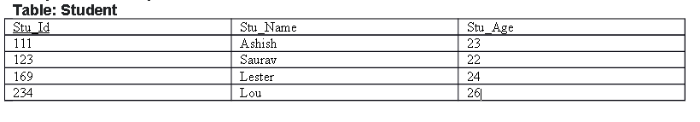
Table
A table is a collection of data represented in rows and columns. Each table has a name in database.
For example, the following table “STUDENT” stores the information of students in database.

Slide 150
Record or Tuple:
Each row of a table is known as record. It is also known as tuple.
Field or Column name or Attribute:
The above table “STUDENT” has three fields (or attributes): Student_Id, Student_Name,
& Student_Age.

Slide 151
Domain
A domain is a set of permitted values for an attribute in table. For example, a domain of month-of-year can accept January, February,…December as values, a domain of dates can accept all possible valid dates etc. We specify domain of attribute while creating a table. An attribute cannot accept values that are outside of their domains.
For example, In the above table “STUDENT”, the Student_Id field has integer domain so that field cannot accept values that are not integers for example, Student_Id cannot has values like, “First”, 10.11 etc.

Slide 152
Relational Schema
It is the logical blueprint of the relation i.e., it describes the design and
the structure of the relation.
It contains the table name, its attributes, and their types:
TABLE_NAME(ATTRIBUTE_1 TYPE_1, ATTRIBUTE_2 TYPE_2, ...)
For our Student relation example, the relational schema will be:
STUDENT(ROLL_NUMBER INTEGER, NAME VARCHAR(20), CGPA FLOAT)

Slide 153
Relation Key
It is an attribute or a group of attributes that can be used to uniquely identify an entity in a table or to determine the relationship between two tables. Relation keys can be of 6 different types:
Candidate Key
Super Key
Composite Key
Primary Key
Alternate Key
Foreign Key

